Slide 1
Cost-Effective High Voltage Motor Controller for Automotive Use
sdmay25-26 Bryce Rega, Marek Jablonski, Gavin Patel, Jonah Frosch, Long Yu
May 7th, 2025
Cheng Huang (chengh@iastate.edu)
Notes:
Marek

Slide 3
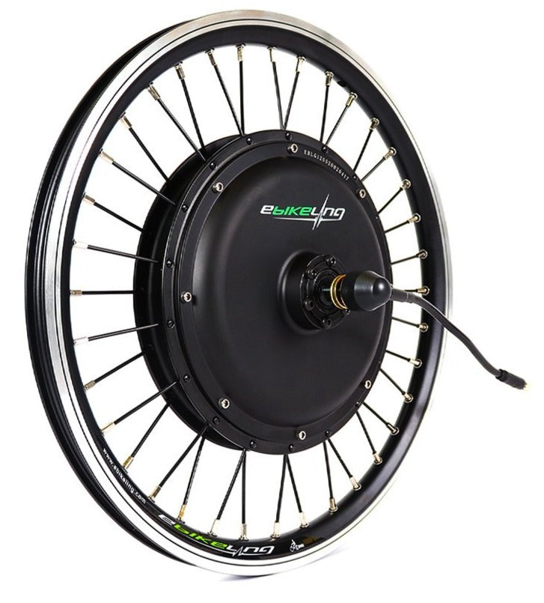
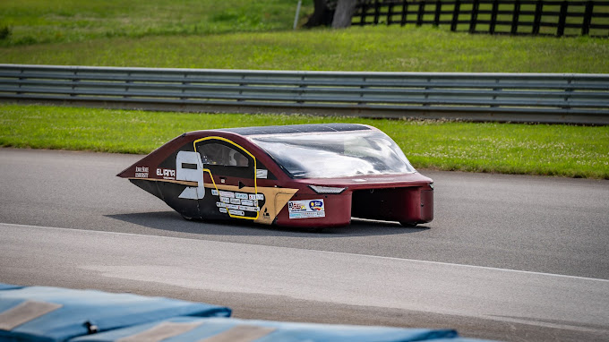
Problem Statement
There exists a market gap in lightweight EV motor controllers
Used in collegiate solar cars and electric bikes
These unique applications have unique specs
Low RPM (0-1000)
High Torque (Direct Drive)
High/Medium Voltage (48-135V)
Medium Power (Peak ~7.5KW)
Problem: Existing controllers
Are very expensive (~$7k each)
Black boxes to those who use them
Notorious for having issues.
Electric bike in-hub motor
ebikeling.com
PRISUM's solar car, P15 Eliana
PRISUM Media Archive
Notes:
Marek

Slide 4
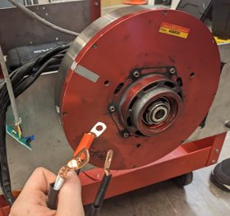
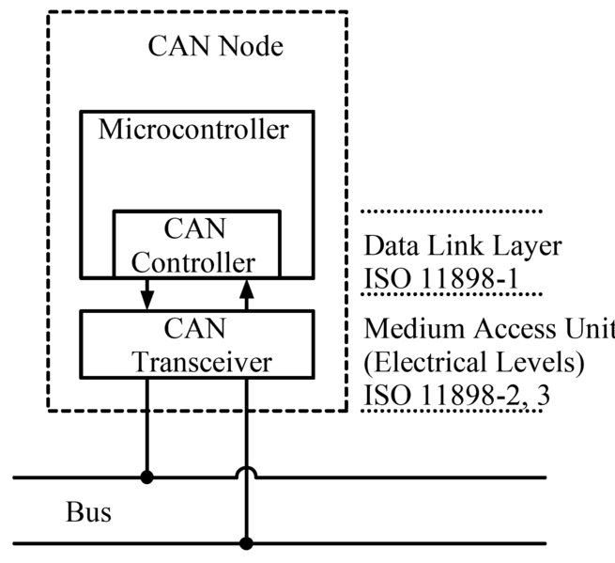
Functional Requirements
Operational
Spin Motor in either direction
Current and/or speed controlled
Electrical
0-900rpm Electrical Rotation speed
48-135VDC Power Input
50A Bus Draw
200A Peak Coil Current
High Torque Output
Communication
CAN bus command/status IO
Used in large interconnected vehicles
GPIO interface
Simple Bare-bones operation
Mitsuba 2096-III Motor
Marek Jablonski
CAN Node Diagram
CAN bus - Wikipedia
Notes:
Marek

Slide 5
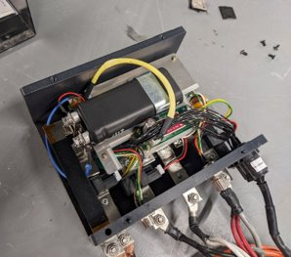
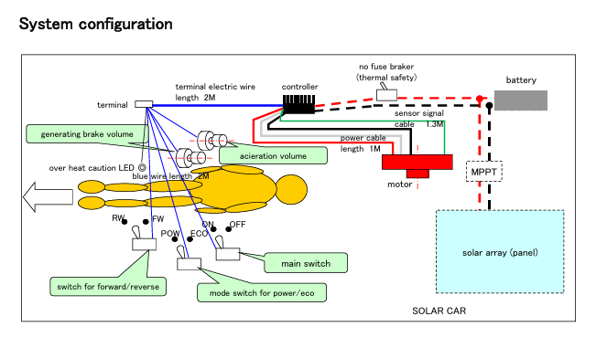
Nonfunctional Requirements
Compact and Lightweight
200x200x100mm outer dimension
Less than 4kg
Environmental Resistance
0°-45°C Operating ambient
Water-resistant connectors
Aesthetics
Useful Labeling
Professional Design
User Experience
Comprehensive Documentation and Guides
External Configuration Utility
Mitsuba 2096C Controller
Marek Jablonski
Existing hookup Diagram
Mitsuba M2096 Controller Manual
Notes:
Marek

Slide 6
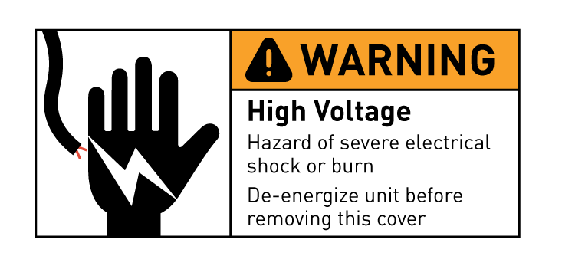
Other Considerations
Open-Source Design
Removes Overhead from User Cost
Enables Cost cuts for resourceful Users
Safety
Dangerous Voltages/Energy
Electrical Isolation
Energy Dissipation
Cautions/Warnings
https://www.flickr.com/photos/lintmachine/2333562855
Example Hazard Label
Safety in Motor Maintenance and Troubleshooting – Monolithic Power System
Notes:
Marek

Slide 7
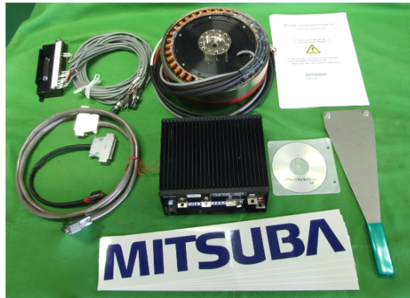
Project Overview
Custom High Voltage Motor Controller
Low Total cost for controller when compared to market options
Develop some user interface for interfacing and configuring controller
Compatible with many different applications
M2096 kit
Mitsuba M2096 Controller Manual (OEM Recommended Controller)
Wavesculpter 22 Controller
(Aftermarket Controller)
Mitsuba 2096-III Motor
(Application Motor)
Notes:
Gavin

Slide 8
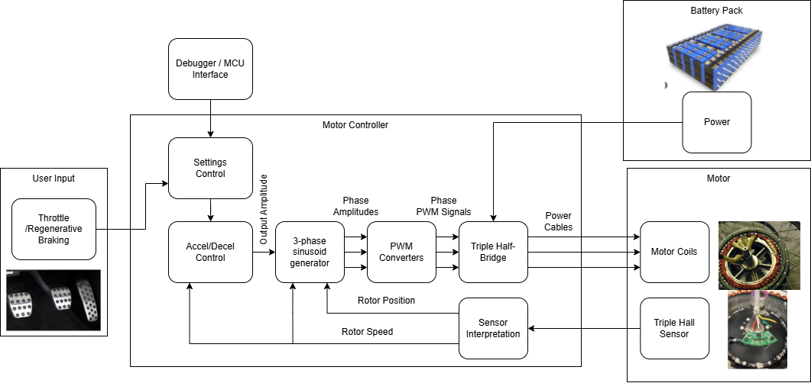
Concept Sketch
Notes:
Gavin

Slide 9
Development Phases
Development Board
Revision 1
Revision 2
Get familiar with software via examples
Setup hardware configurations
Partially meet requirements
Test hardware to learn for next revision
Test basic custom software
Completely meet requirements
Final deliverable
Notes:
Bryce Rega

Slide 10
Development Board Results (Fall 2024)
Determined test motor parameters
Coil Inductance
Internal Resistance
Winding and Pole/Pair Scheme
Too Low Torque
Could barely spin up motor
Frequent OC faults
Control Scheme Issues
Not configured for this motor type
Development Board Failed
Gate Driver internal failure
Necessary information gained beforehand
Notes:
Long Yu
During testing, we found improved motor parameters, particularly in terms of coil inductance and internal resistance and the winding and pole/pair scheme. However, the Development Board encountered torque limitations. The motor could barely spin up, and we frequently experienced overcurrent faults. Another challenge was with the control scheme, which was not configured optimally for this specific motor type. Lastly, the Development Board failed due to an internal gate driver failure. But, we had already gathered the necessary information about motor parameters and system behavior before this happened, this will be helpful in guiding our next steps.

Slide 11
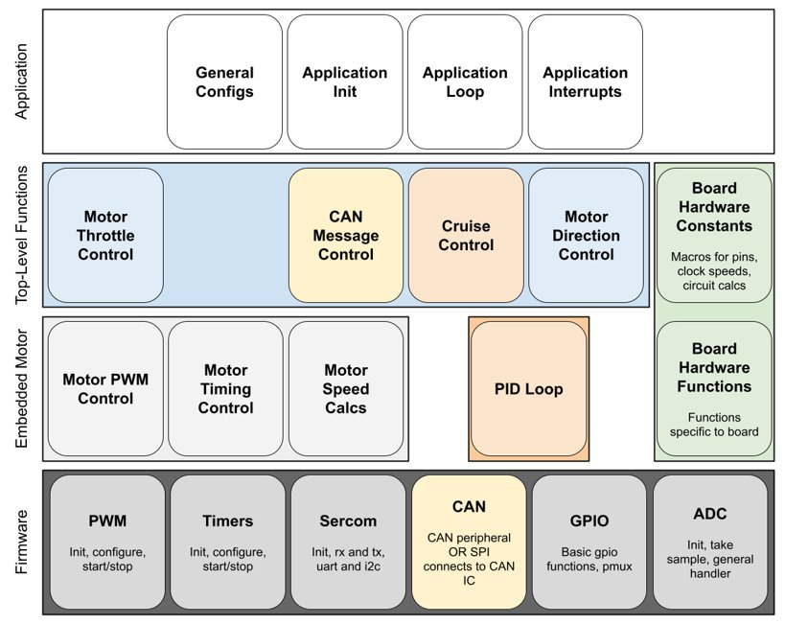
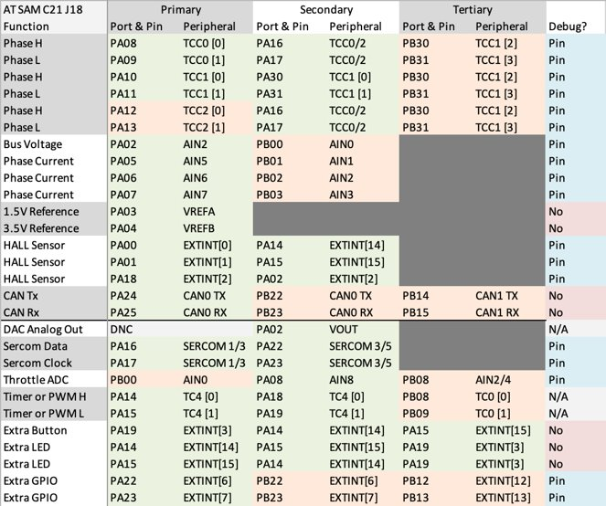
Revision 1 Software Design
Software Design Diagram
MCU Pinout
Notes:
Bryce Rega

Slide 12
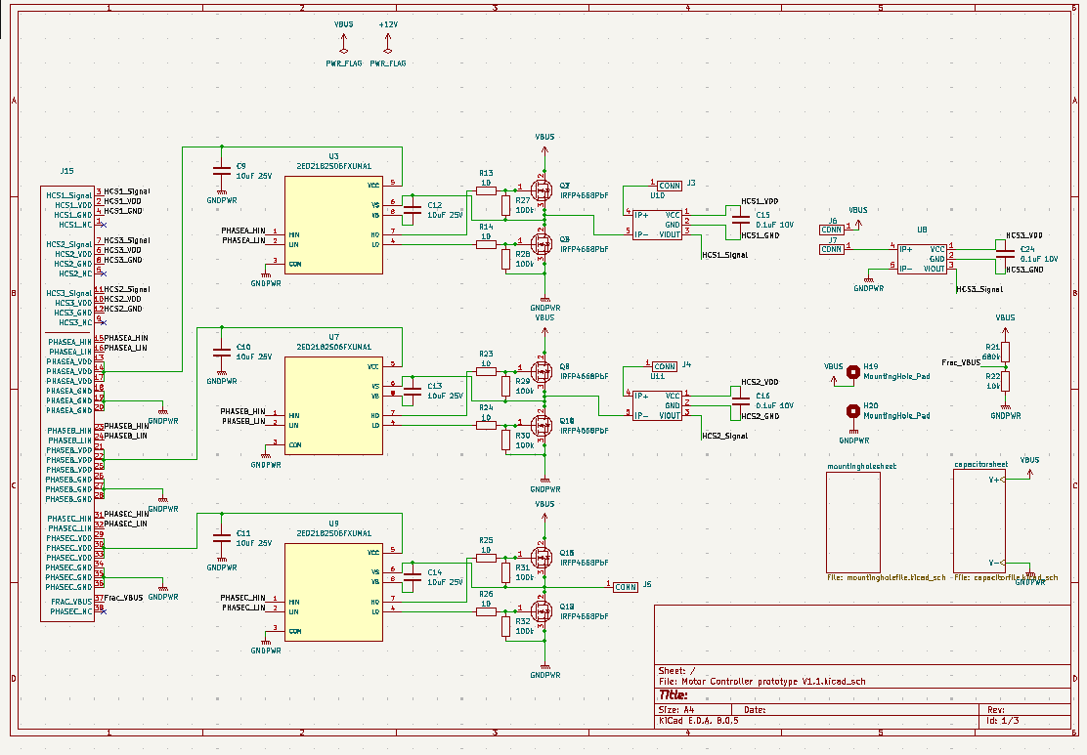
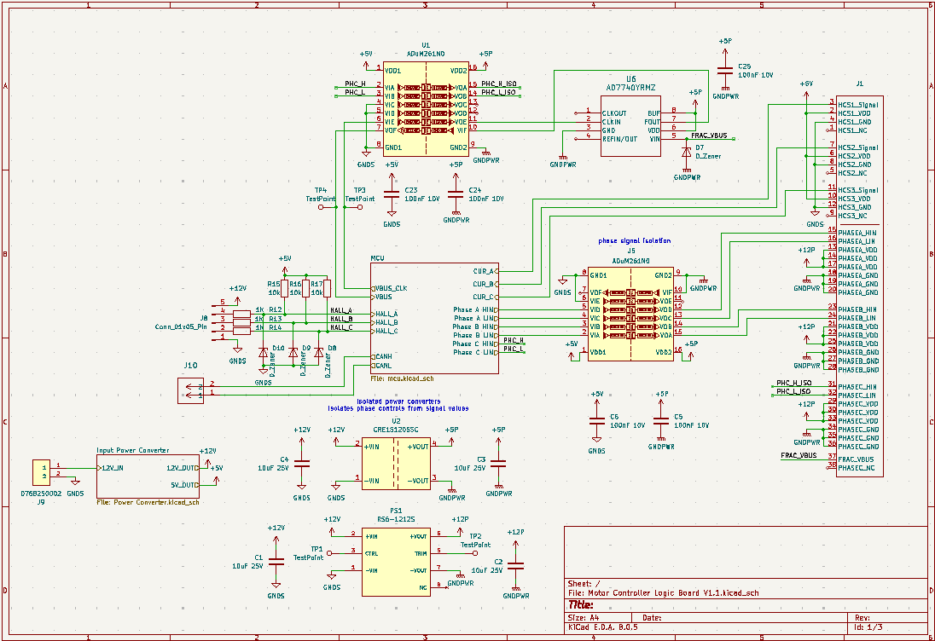
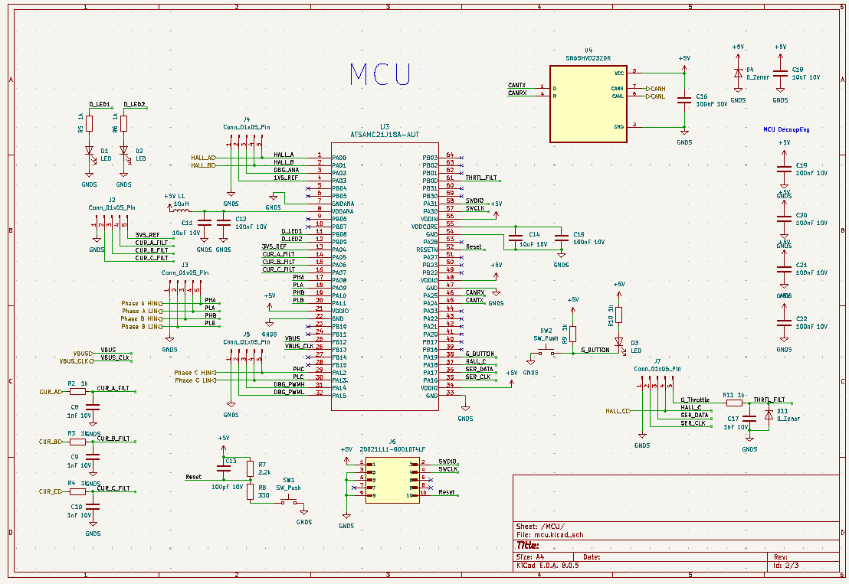
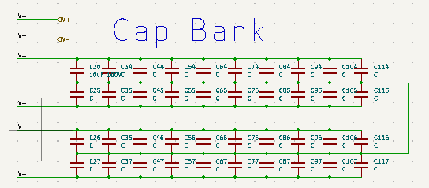
Revision 1
Power Board
Main Board, Contains all high power circuitry
Logic Board
Daughter Board to Power Board, Contains MCU
Logic Board Top Level
Power Board Top Level
High Voltage Capacitor Bank
Logic Board MCU
Notes:
Marek

Slide 13
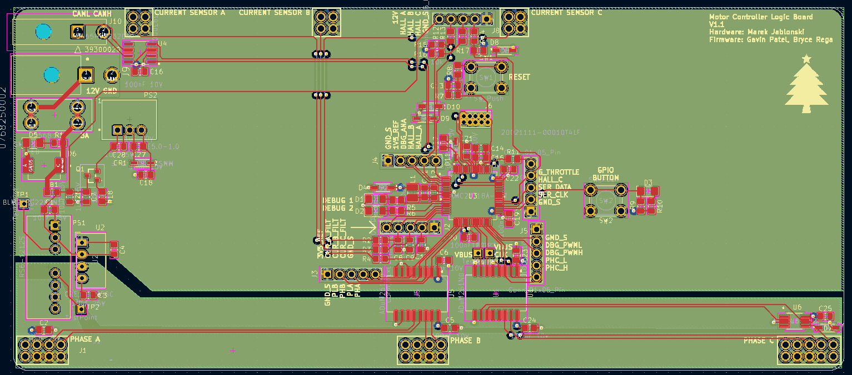
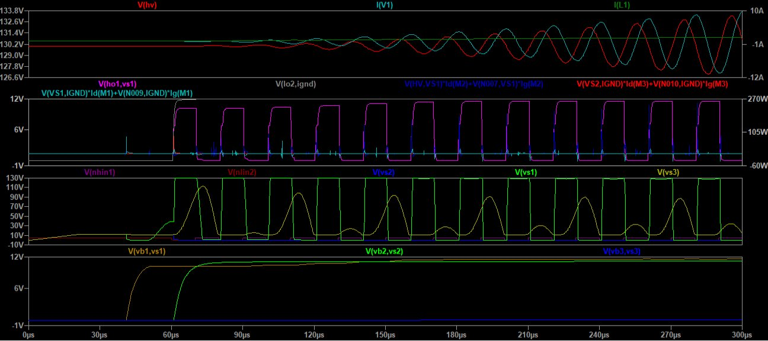
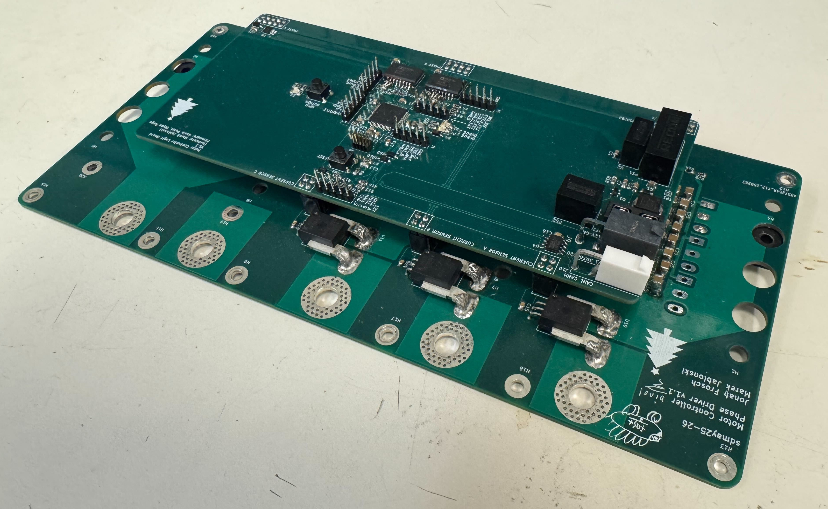
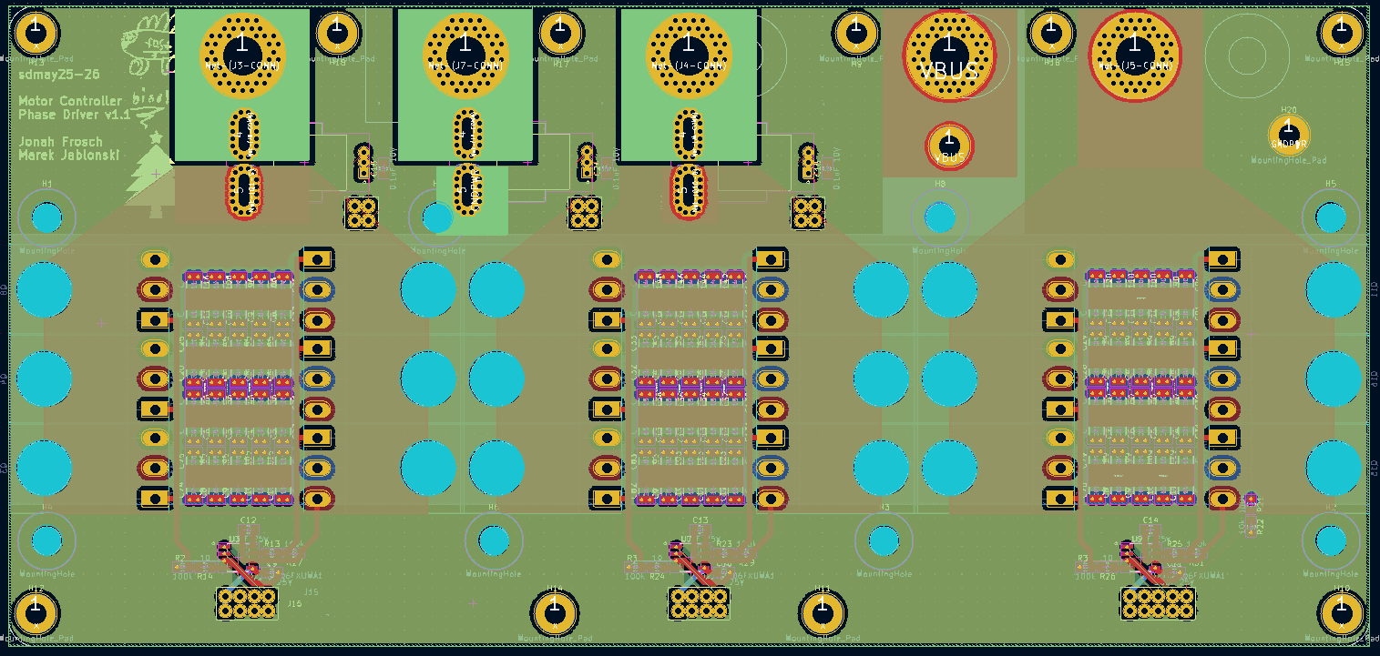
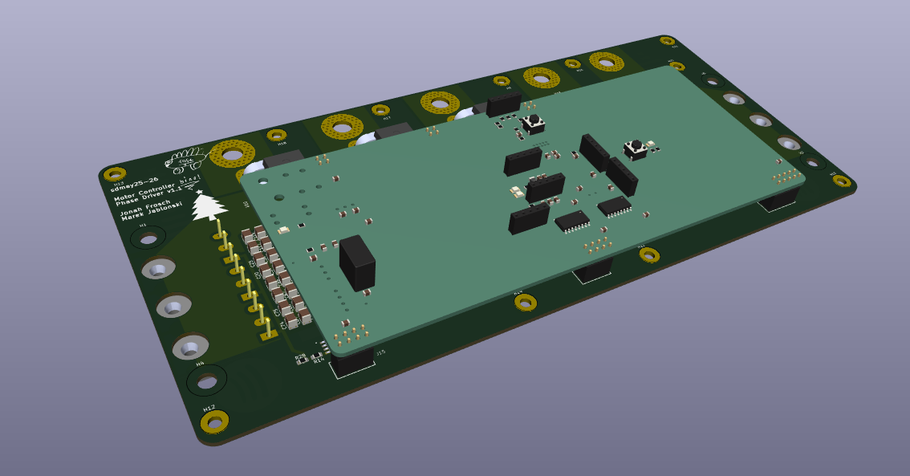
Revision 1 Design
Switching Characteristics simulation
Current Layout of Rev 1 Logic Board
Schematic for the MCU in Rev 1
3D View of Rev 1 Layout
Notes:
Marek

Slide 14
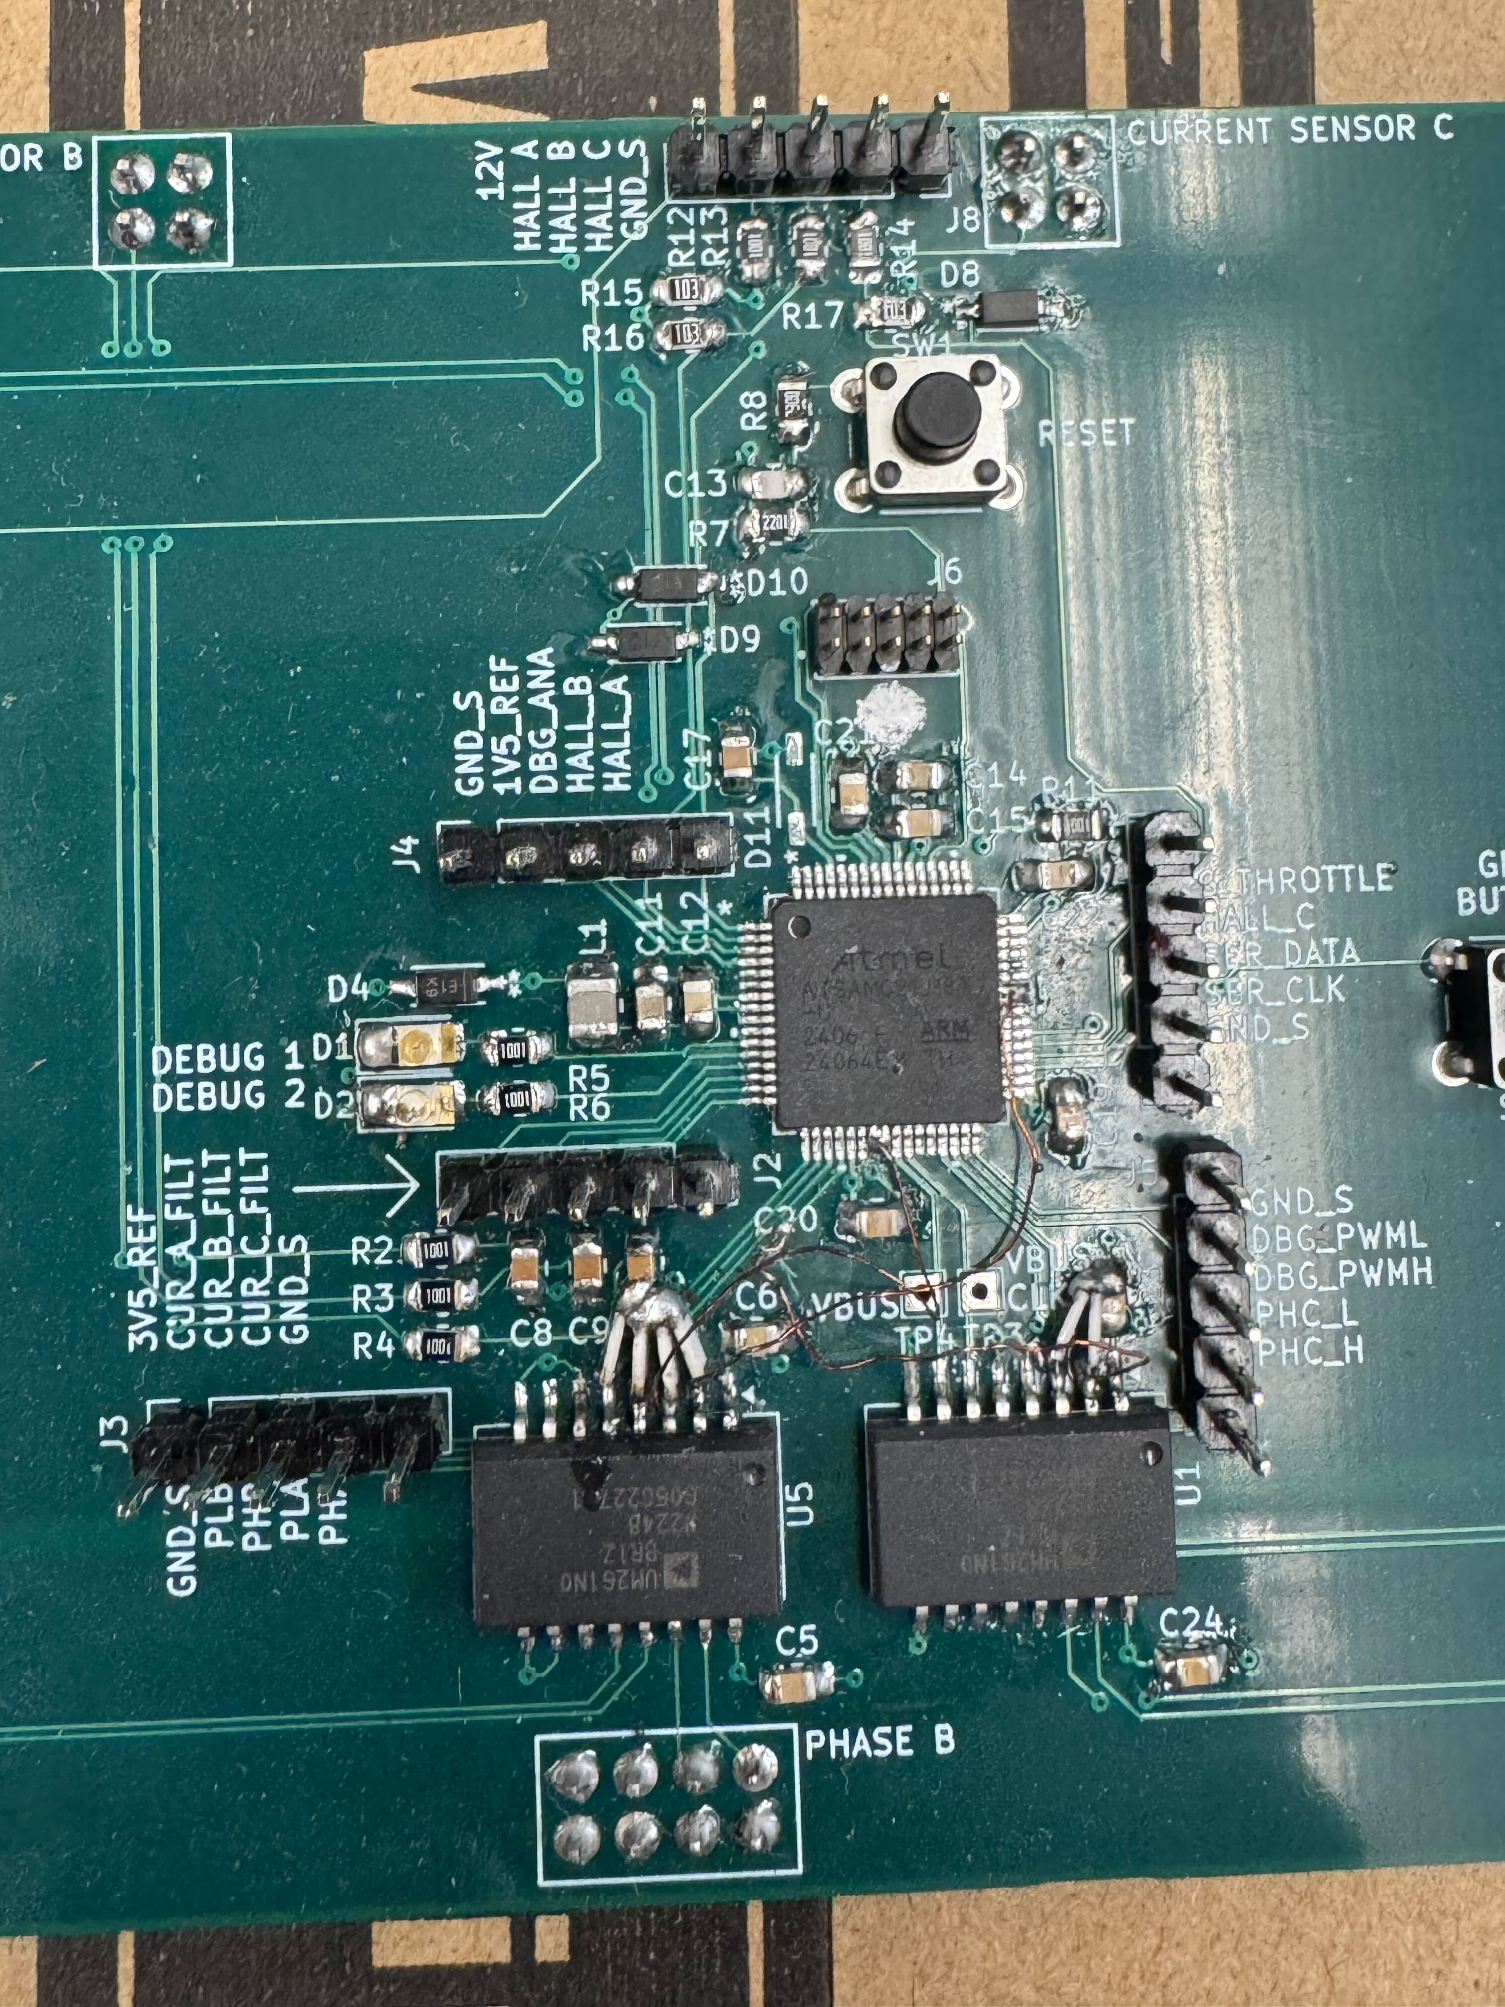
Revision 1 Outcome
Hardware issues identified for revision 2
Capacitors didn't meet specification
~50% less than expected
Lack of test points, labels on board
Pinout for MCU incorrect
Floating Outputs Present under Reset
Software In Progress
Spun slowly (~30rpm) at a fixed speed
Fasters speeds non-functional
No current/torque based control
Analog throttle input functional
Rev 1 Temporary fixes implemented
Jonah Frosch
February 2025
Notes:
Bryce Rega

Slide 15
Revision 2 Pinout
Phase PWM channels are swapped
Built in features on MCU
Additional I/O
Buttons, LEDs, Serial
Move throttle analog channel
More debug pins
Pin Name/Func Peripheral Pin Name/Func Peripheral
Notes:
Bryce Rega

Slide 16
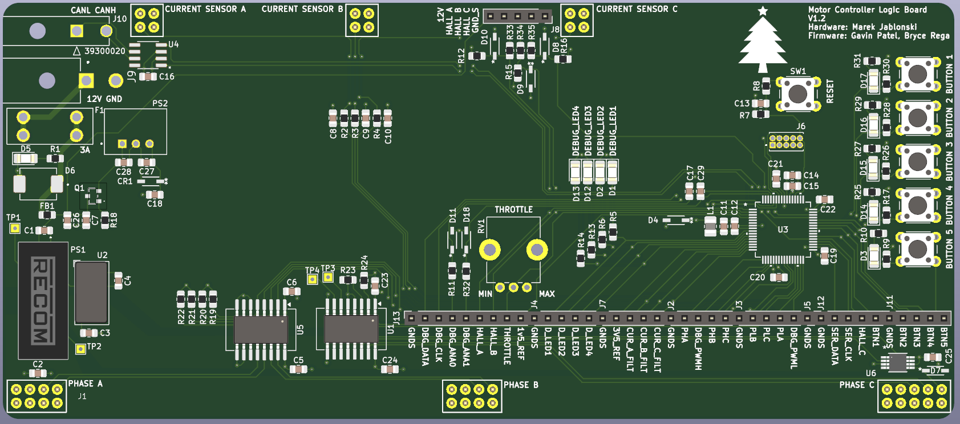
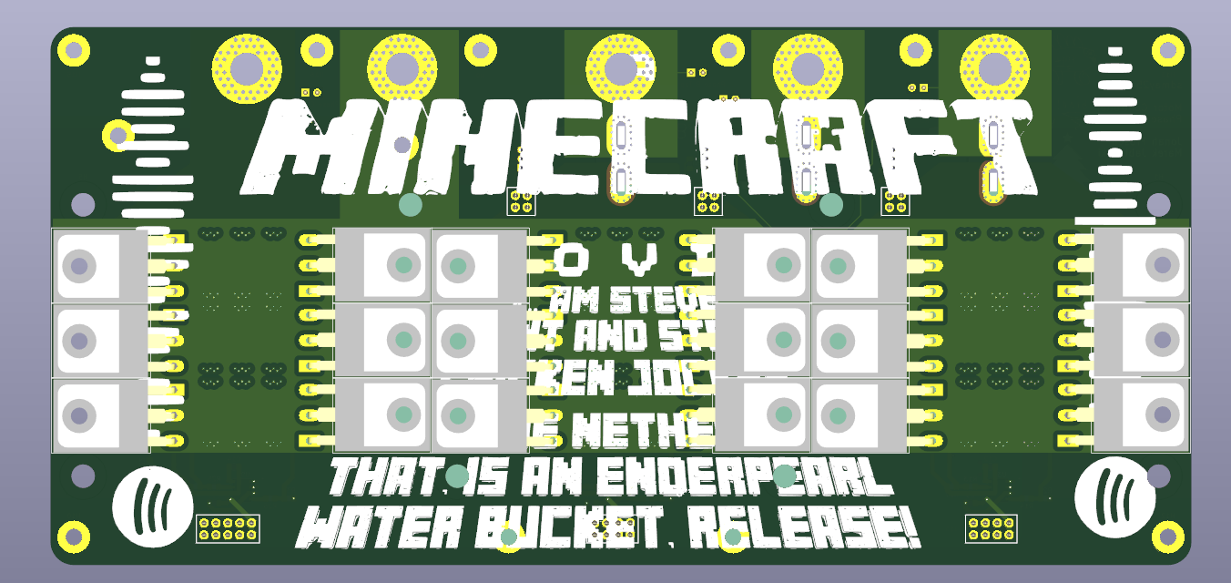
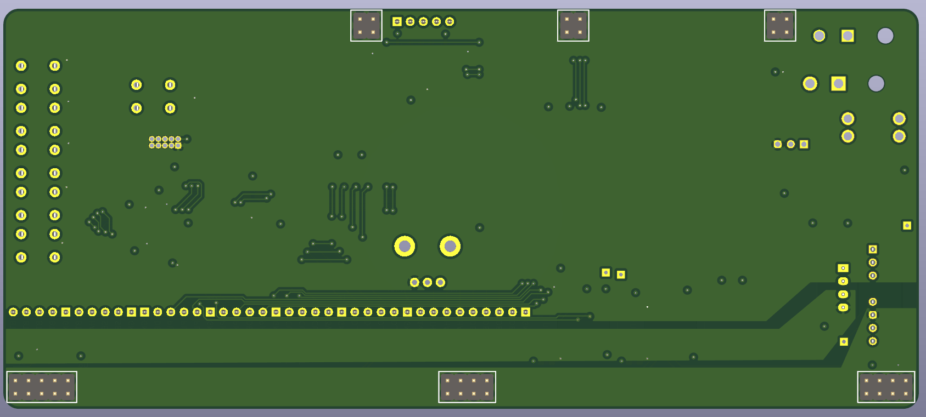
Revision 2 Design
Power Board Rev. 2
Logic Board Rev. 2
Power Board Layout Top
Logic Board Layout Top
Power Board layout Bottom
Logic Board Layout Bottom
Notes:
Jonah

Slide 17
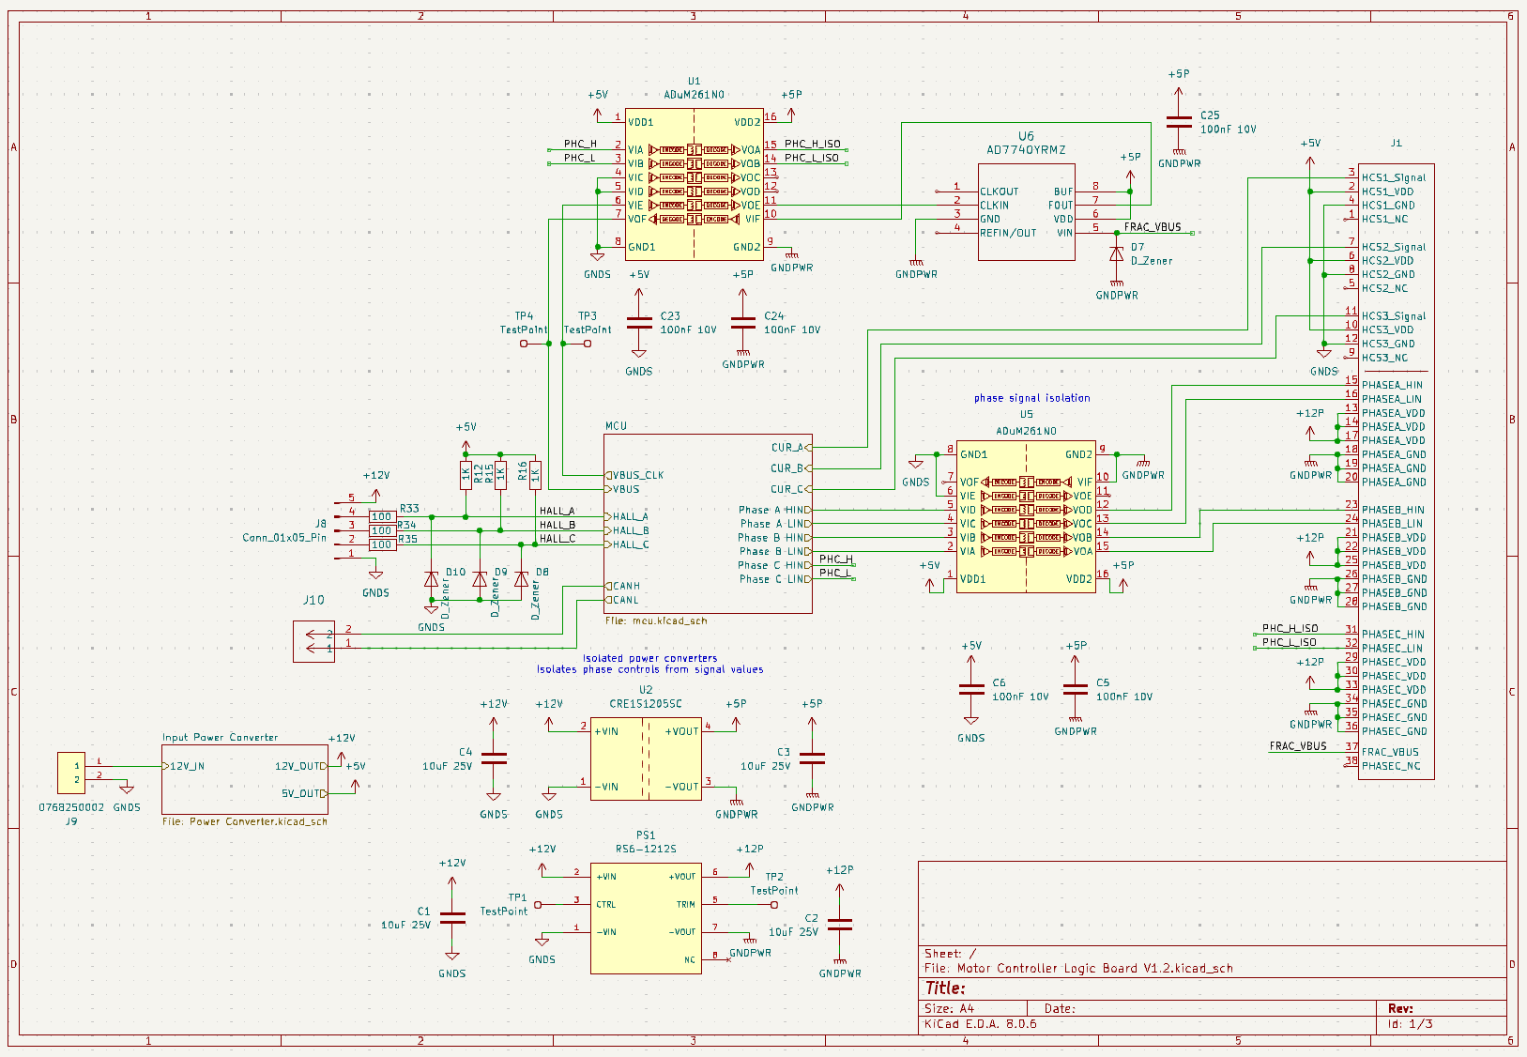
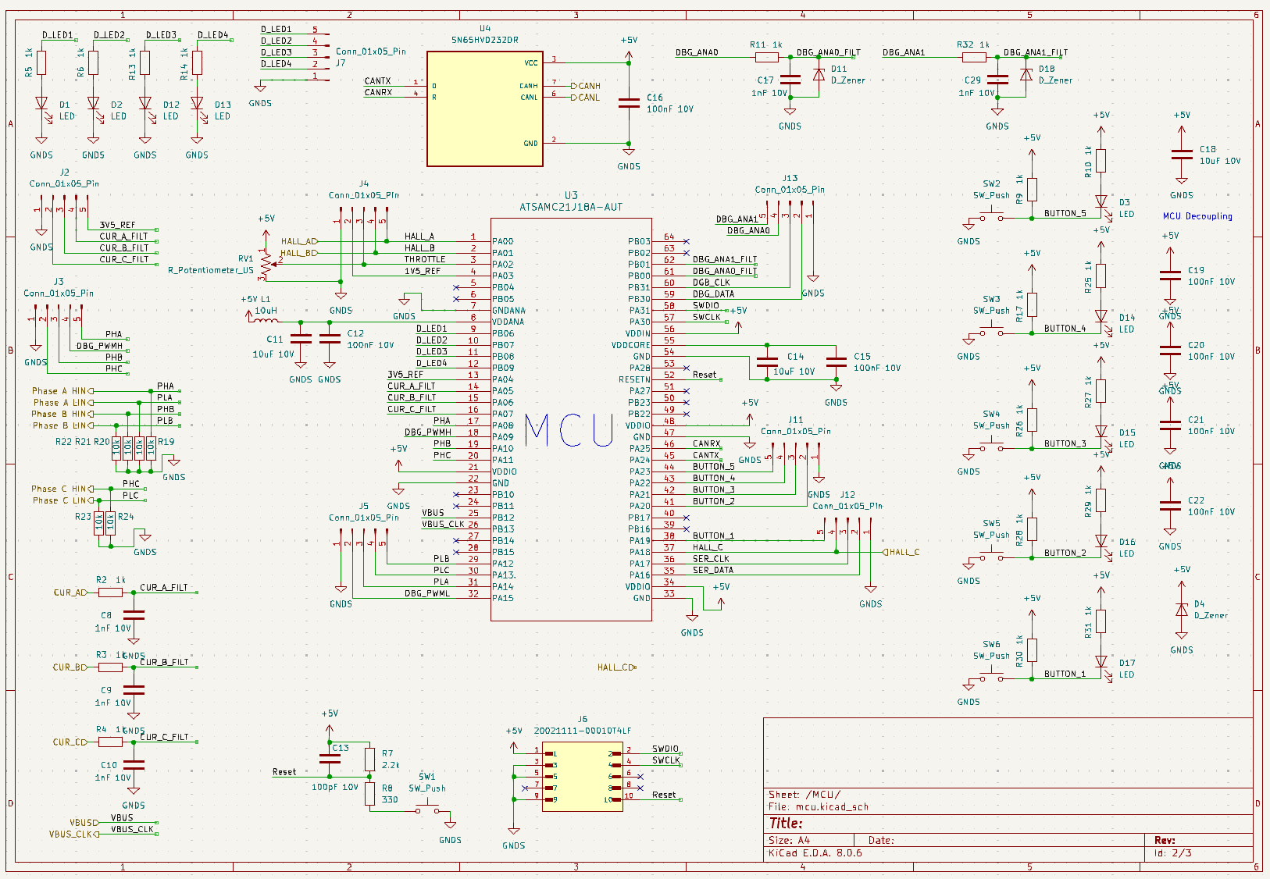
Logic Schematic
Top Level Schematic
Power Converter Schematic
Microcontroller Schematic
Notes:
Jonah

Slide 18
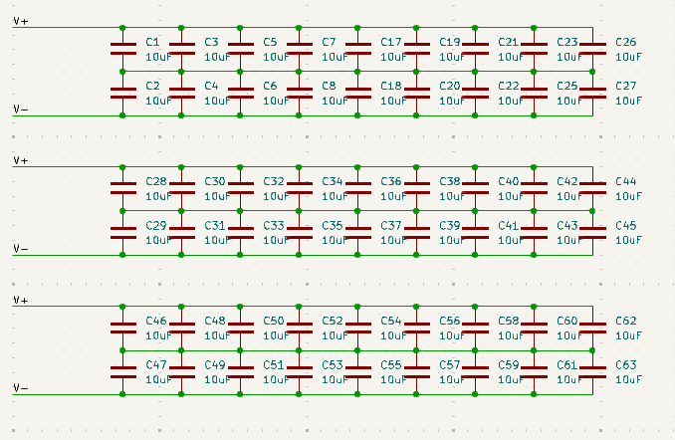
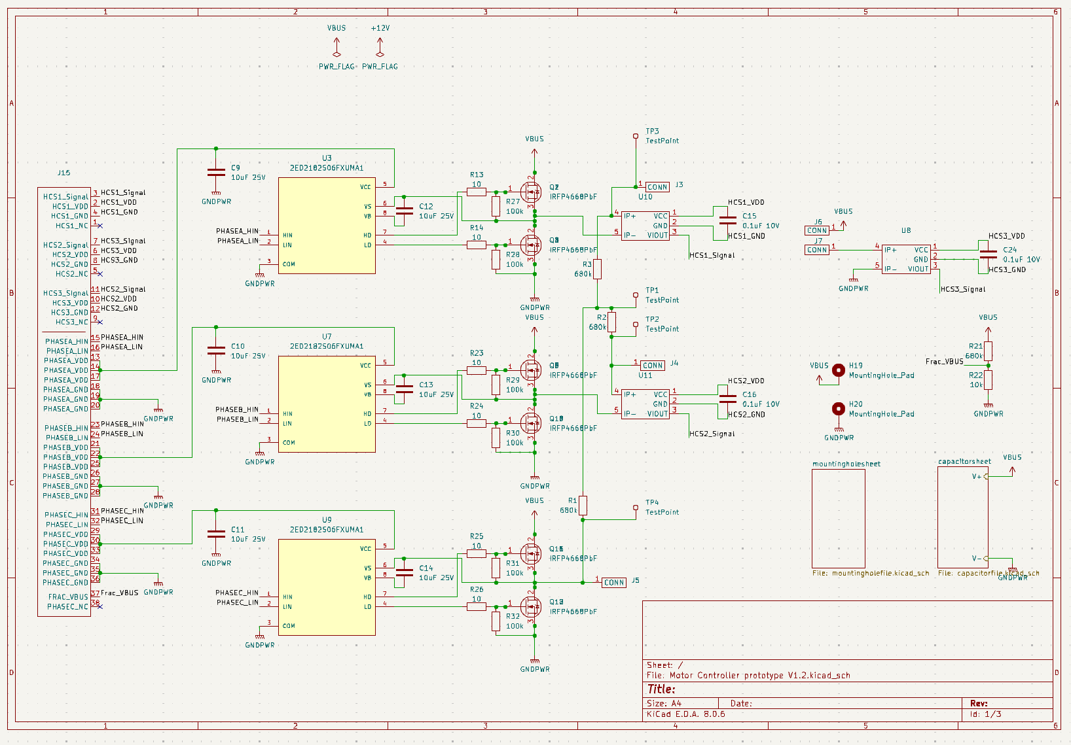
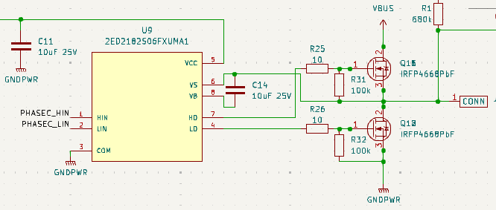
Power Board Rev. 2 Schematic
High Voltage Capacitor Bank
Gate Drivers
Gate Driver + Gates
Notes:
Jonah

Slide 19
Gate Driver Design
Gate Driver
Notes:
Jonah

Slide 20
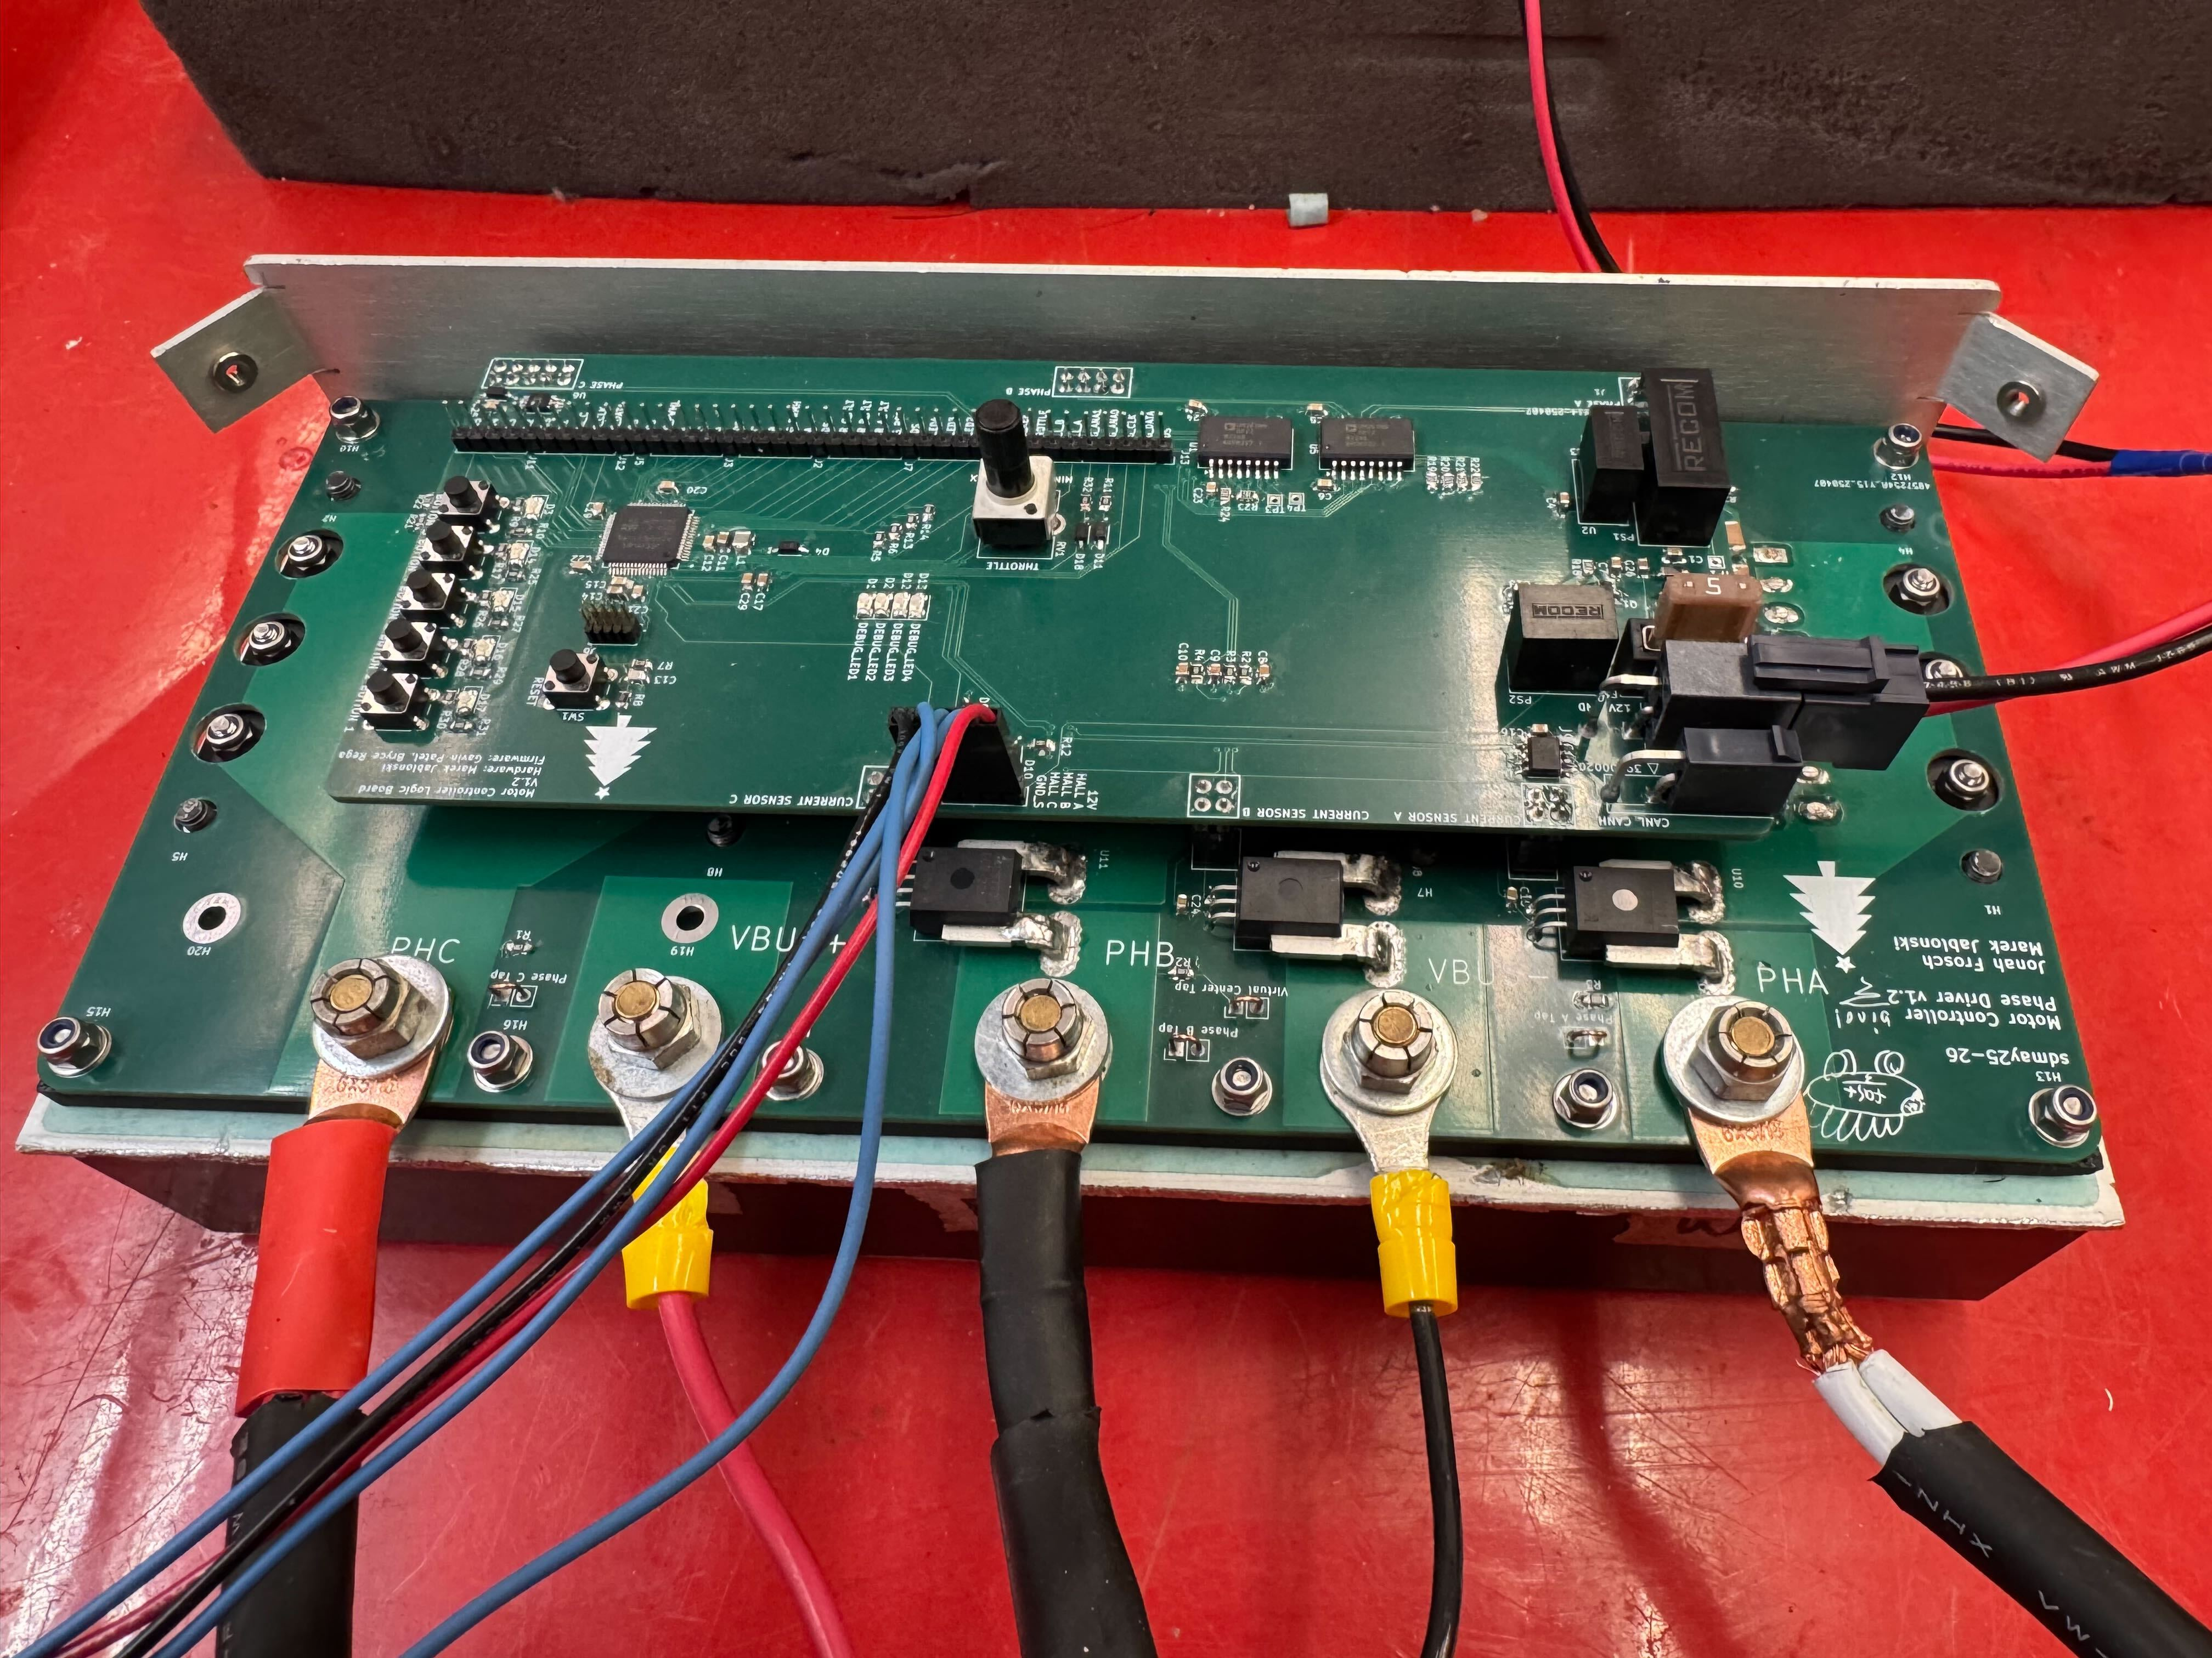
Testing
Hardware Testing
Connectivity and Capacitor Performance Verification
High voltage tests to verify gate driver operation
Software Testing
Verify PWM operation is as expected
Test rotation speeds and their efficiency
Control over CAN communication
Notes:
Gavin

Slide 21
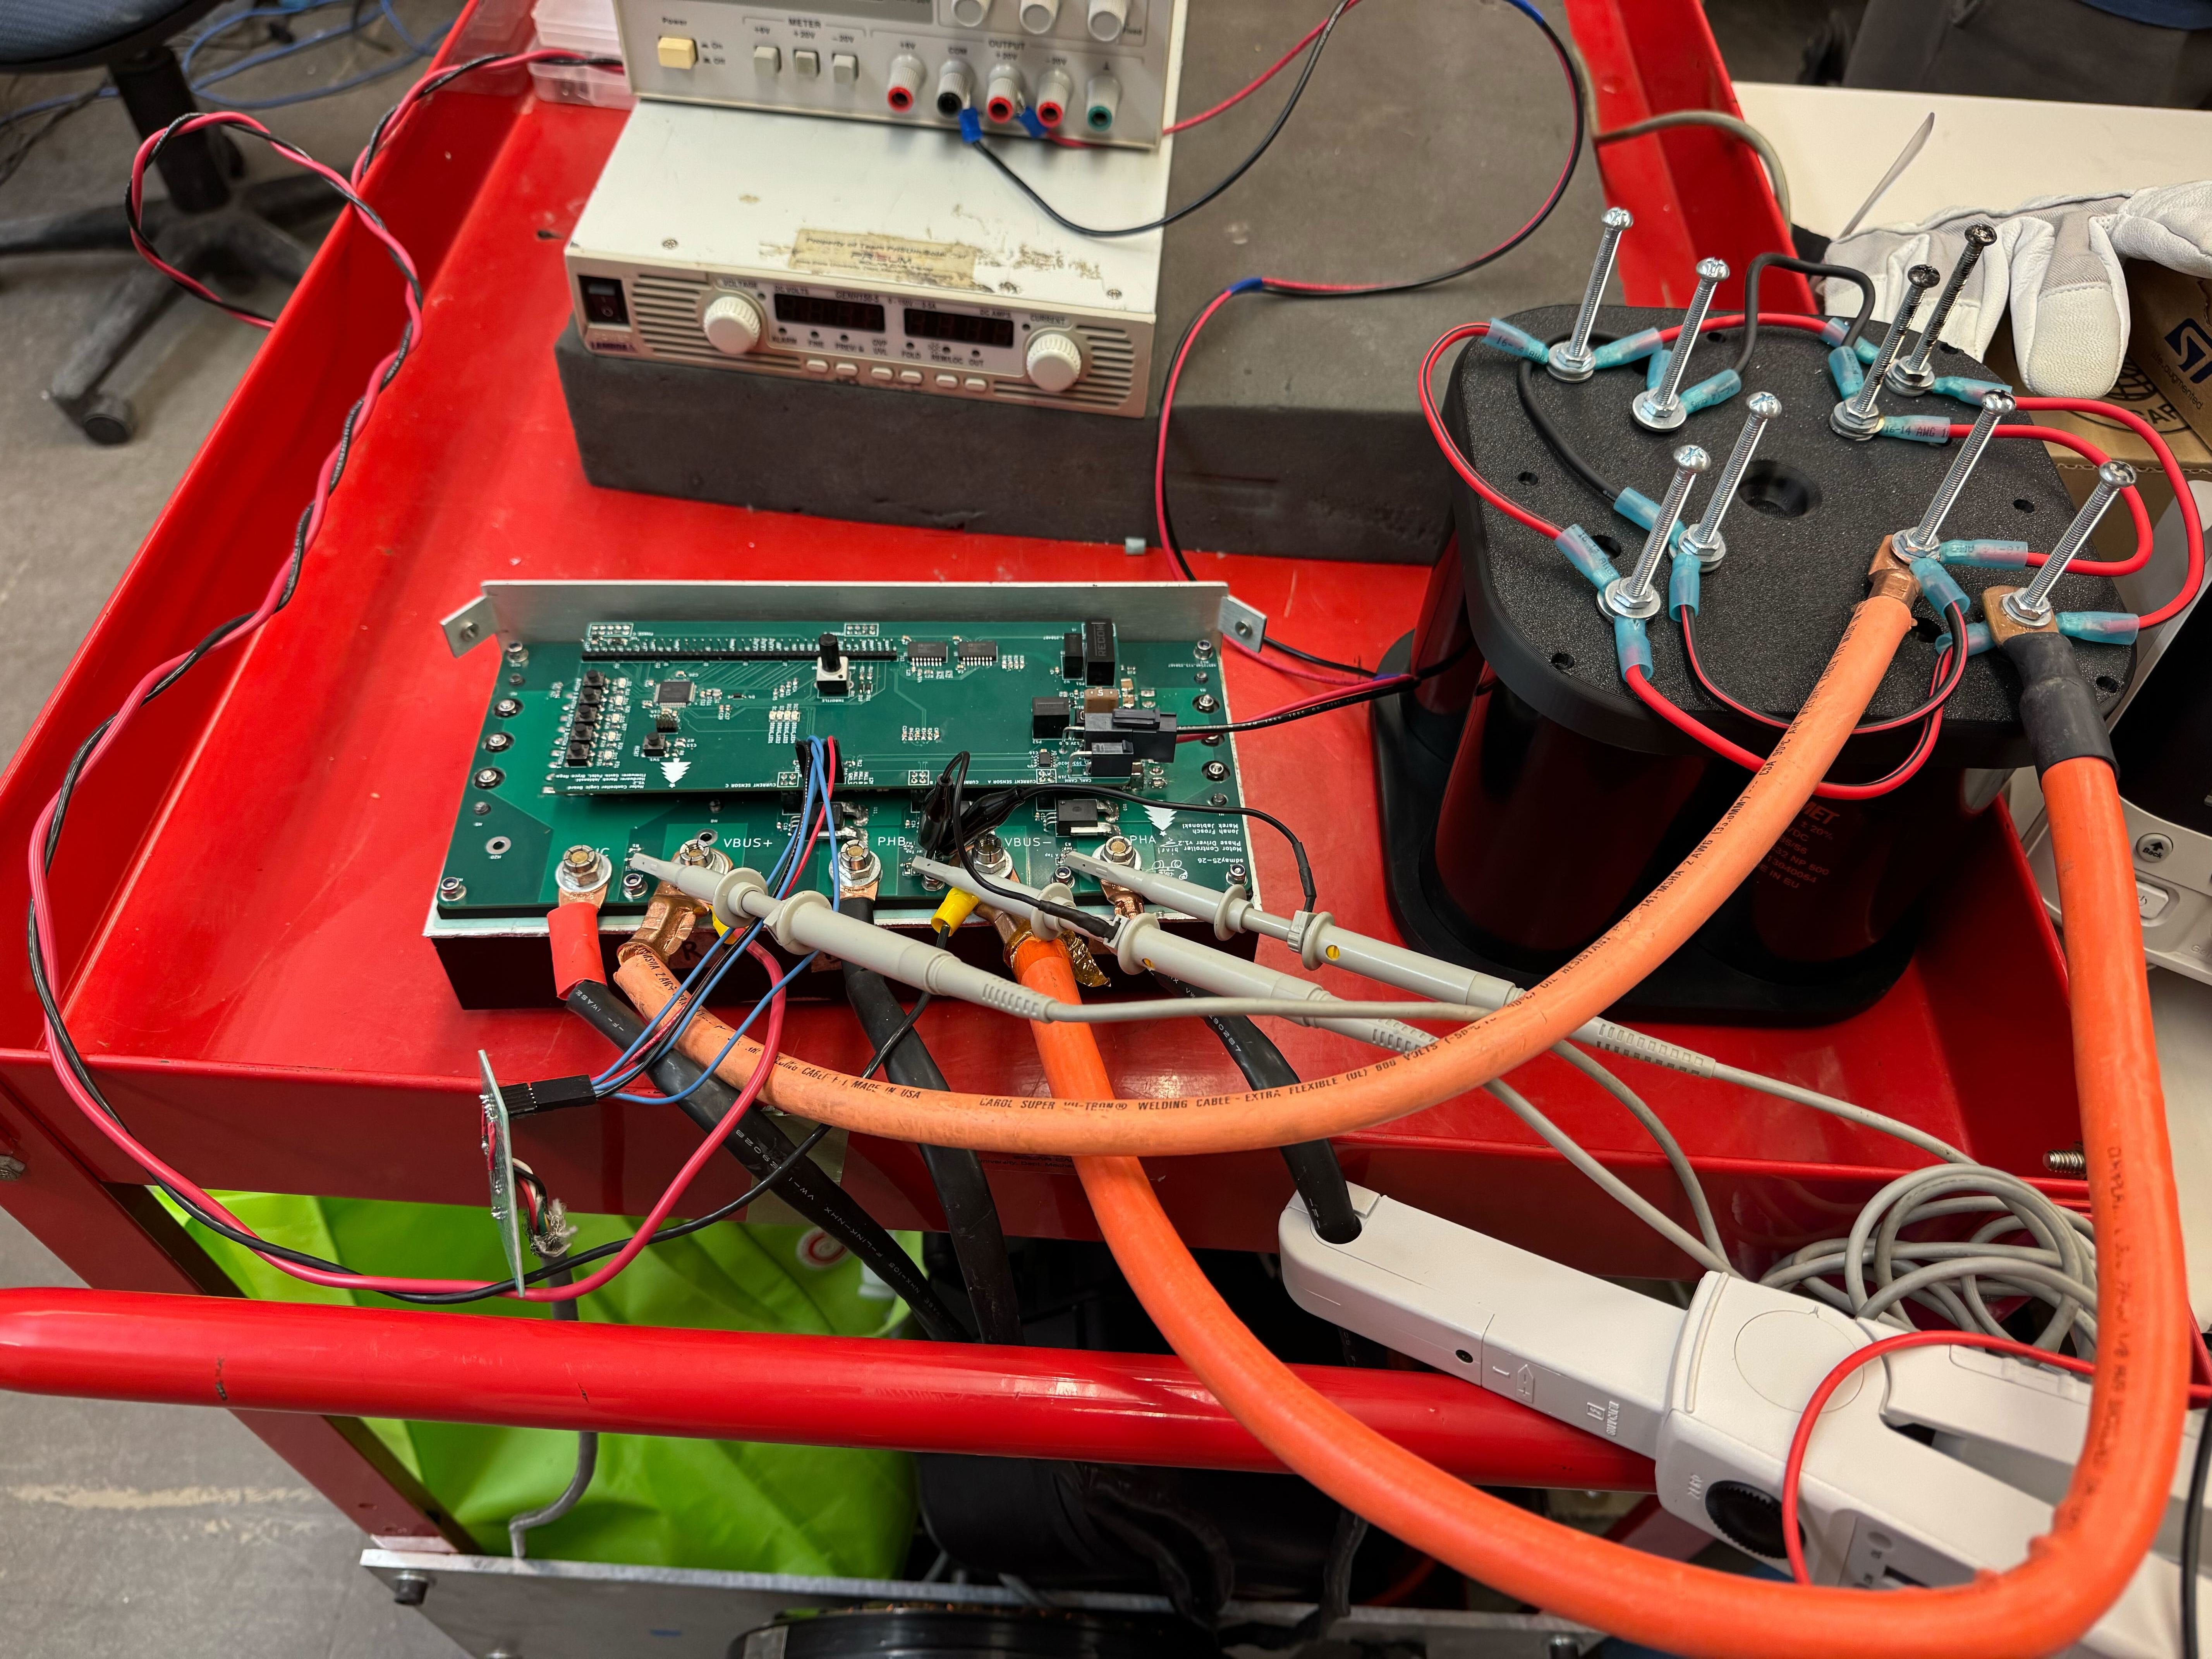
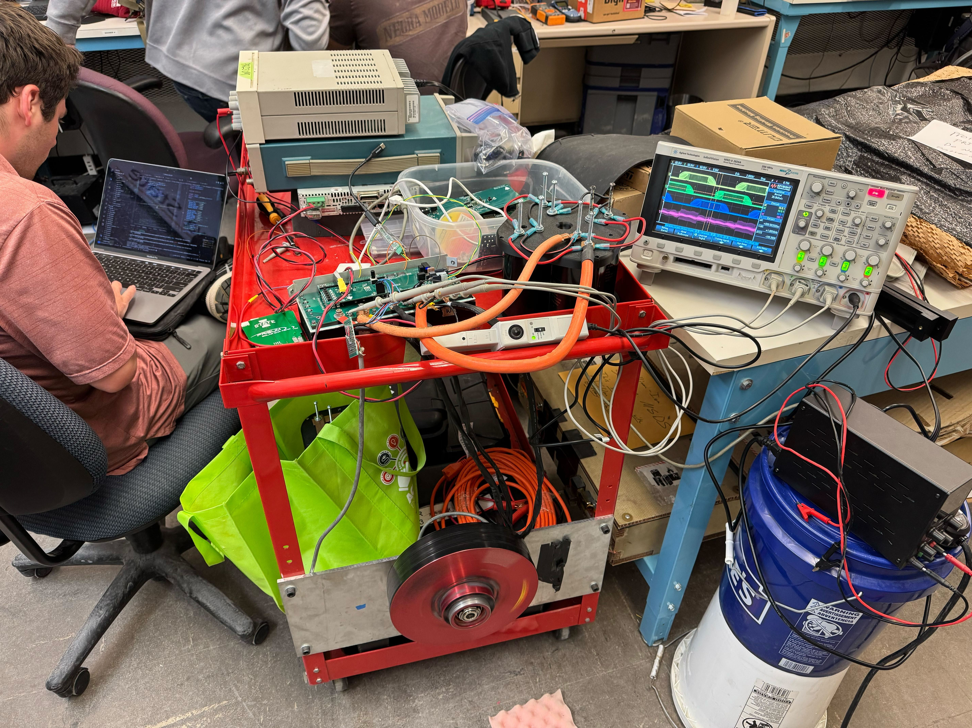
Revision 2 Outcome
Hardware Progress
Operationally Performed as Expected
Larger than expected voltage fluctuations at input
Likely due to using SMPS at input instead of Battery
Fixed with large Electrolytic capacitor bank
Software Progress
PWM Control from stall to ~1050rpm
Analog throttle control
No current/torque based control
Notes:
Long Yu
In Revision 2, we addressed several key hardware and software challenges. On the hardware side, we encounter larger than expected voltage fluctuations at input. It is likely due to the use of switch mode power supply instead of a battery. This was resolved using a large electrolytic capacitor bank, allowing the system to operate as expected. On the software side, we successfully implemented PWM control, achieving speeds up to 1050 rpm, and also board level analog and CAN input. However, current and torque-based control is still pending.

Slide 22
Demonstration
Notes:
Long Yu

Slide 23
Project Costs
Senior Design Cost Breakdown ($)
PCBs | $198.30
PCB Components | $517.06
Dev Board | $104.86
Ext. Capacitor | $50
Misc. Hardware | $17.95
Heatsink Estimate | $65
Total | $949.67
Product Cost Per Unit Breakdown($)
PCBs | $20.88
PCB Components | $318.92
Misc. Hardware | $17.92
Heatsink Estimate | $65
Total | $422.75
Notes:
Jonah44

Slide 24
Challenges and Lessons Learned
Reputable sources give more accurate specifications
Building software for multi-platform support takes time
Likely not worth using the limited time in senior design for it
Communication of expectations
Hardware didn't know what software didn't know
Software thought they knew what hardware wanted but didn't
Notes:
Bryce Rega

Slide 25
Future Work
High Load Testing
Build/Setup Test Dyno
On-vehicle Testing
Unable to perform High-Load Testing
Late Timeline
Unavailability of a test Dyno
Test Vehicle Expects Current/Torque based control
Deeper Hardware Testing
Power Supply Variations
Battery/Power Supply, Ceramic, Electrolytic combinations
Analyse Switching Power Loss
Different Gate Drive parameters
Loss/gain from additional gates
PID Current Control
Target a current instead of Duty Cycle
Tuning
Controlled regenerative braking
Improved Control Theory
Sinusoidal drive function
"Shuffle" away from 6-step trapezoidal
Field Oriented Control
Notes:
Gavin

Slide 26
Contributions
Marek
Simulations and applications expertise
Bryce
Fixed dev-board example code, developed control layers and tests
Jonah
Component selection, Schematic design and Layout design
Gavin
Developed board level drivers, began development for GUI
Long
Reasearch and order parts, updated documents and websites
Notes:
Jonah

Slide 27
Questions?

Slide 28
Further Technical Details
Additional content to support what was covered in the high-level slides

Slide 29
Simulation schematic

Slide 30
Simulation waveform

Slide 31
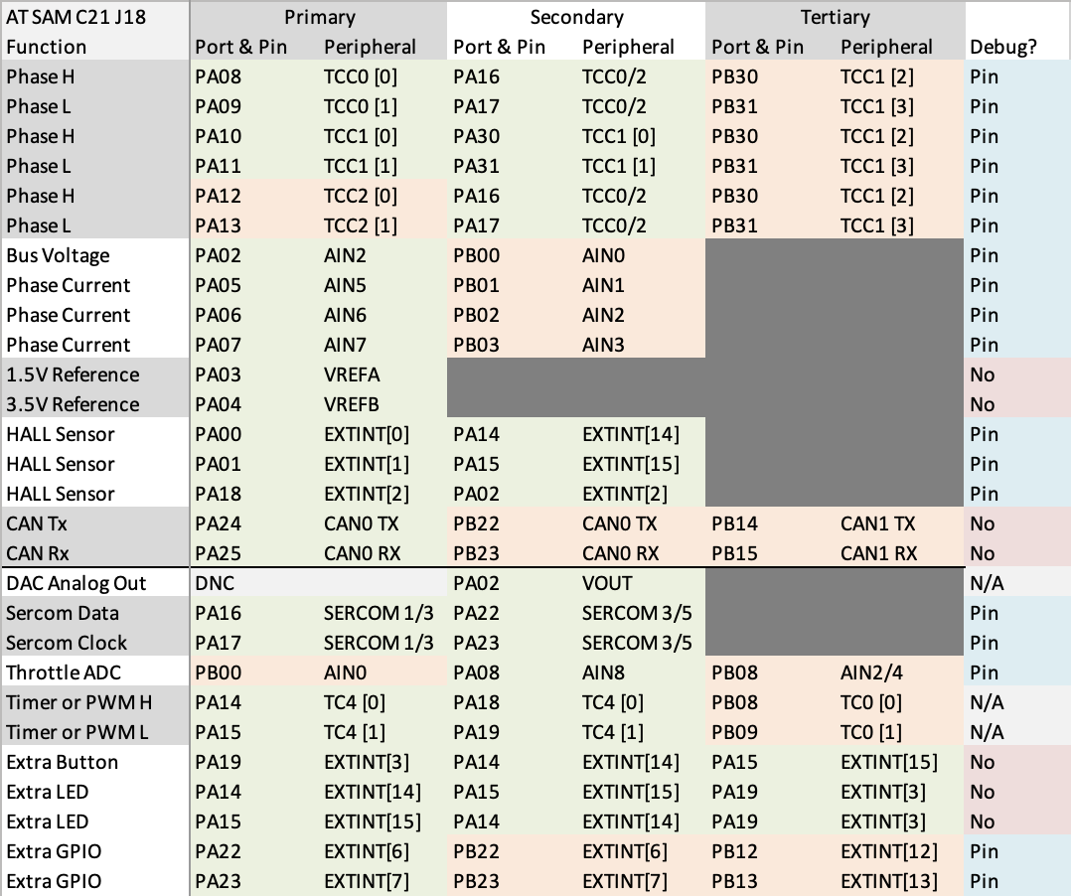
SAM C21 J18 Pinout

Slide 39
Motor Reference Images

Slide 40
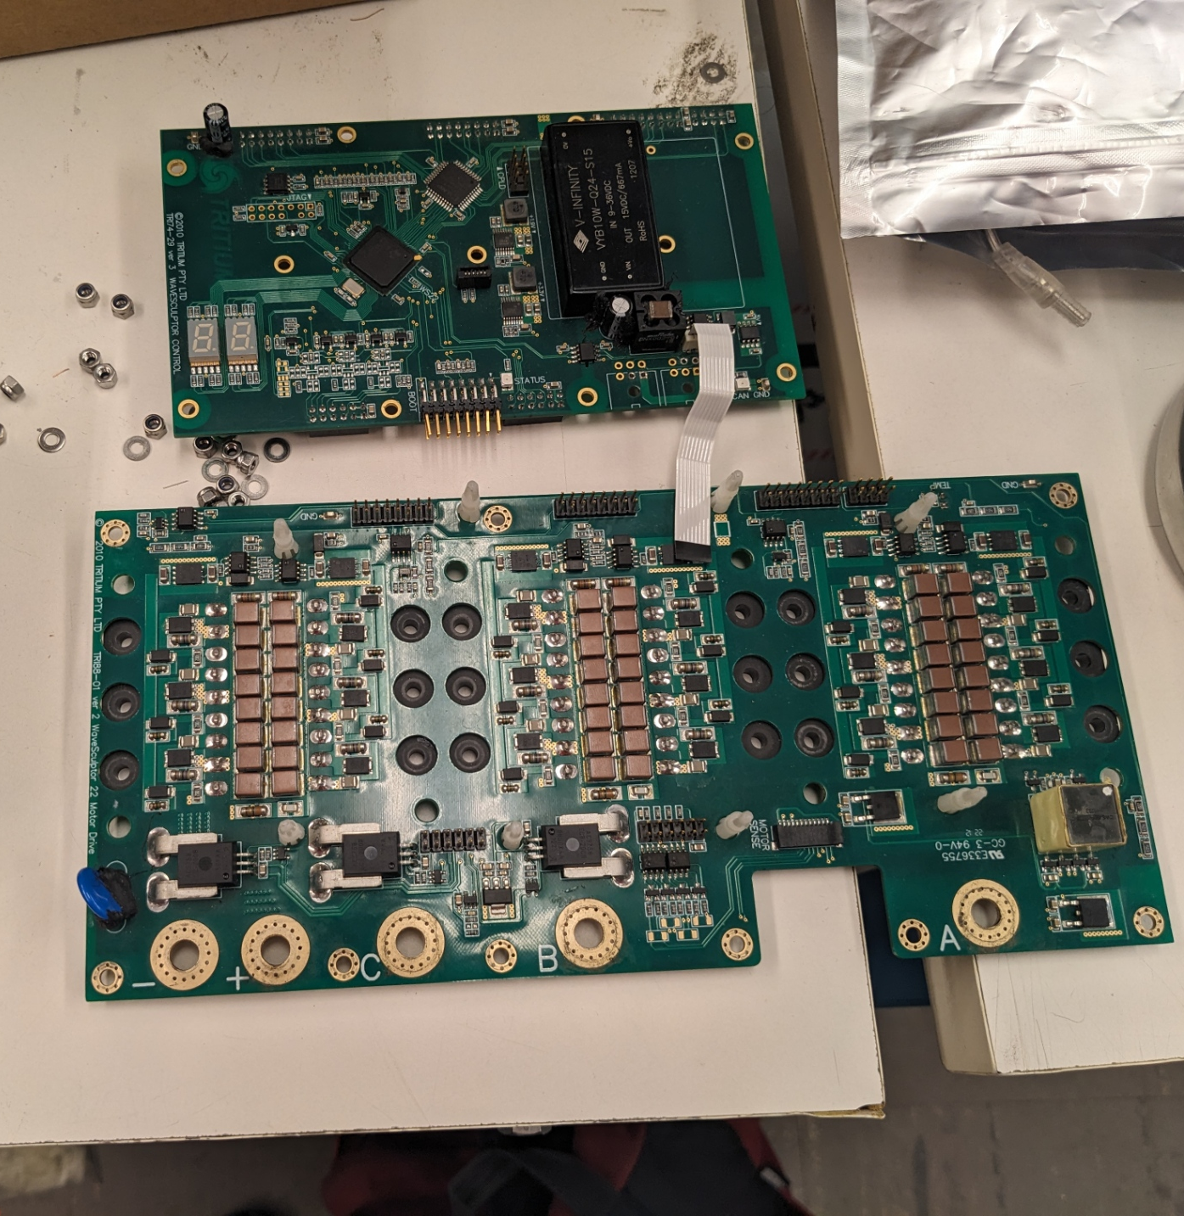
Controller Reference Images

Slide 41
Engineering Standards
IEEE 1547 - Standard for Interconnecting Distributed Resources with Electric Power Systems
This standard outlines requirements for safely interconnecting distributed energy resources (like solar and wind) with electric power systems, focusing on performance, safety, and reliability.
IEEE 1149.1 - Standard Test Access Port and Boundary-Scan Architecture
This standard defines a boundary-scan architecture for testing and debugging integrated circuits and circuit boards, allowing access to internal signals for easier diagnostics without physical probes.
IEEE 1554 - Standard for Software Engineering in the Life Cycle of Digital Systems
This standard provides guidelines for software engineering throughout the life cycle of digital systems, emphasizing structured practices for development, Detroit testing, and maintenance to improve software quality and reliability.

